Slide 1

Note: The data and information in this document is reflective of a hypothetical situation and client. This document is to be used for KPMG Virtual Internship purposes only.
Sprocket Central Pty Ltd
Data analytics approach
[Division Name] - [Engagement Manager], [Senior Consultant], [Junior Consultant]

Slide 2
Note: The data and information in this document is reflective of a hypothetical situation and client. This document is to be used for KPMG Virtual Internship purposes only.
Agenda
Introduction
Data Exploration
Model Development
Interpretation

Slide 3
Note: The data and information in this document is reflective of a hypothetical situation and client. This document is to be used for KPMG Virtual Internship purposes only.
Introduction
To understand the trends and patterns and the buying behaviour of customers, let’s compare old and new customers based on the following factors:
State-wise Analysis
Gender and Wealth segment
Job industry category and car owners
Age of the customers

Slide 4
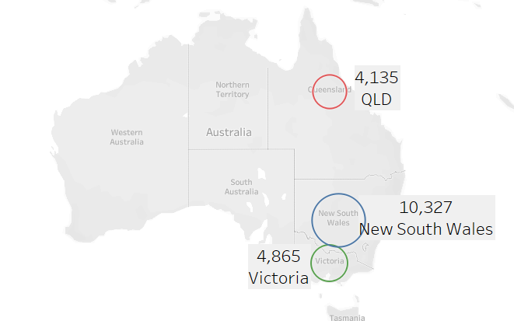
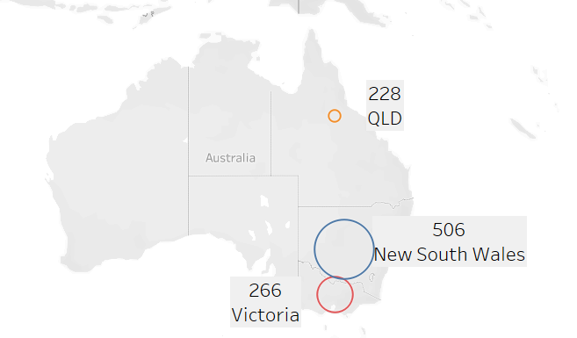
Note: The data and information in this document is reflective of a hypothetical situation and client. This document is to be used for KPMG Virtual Internship purposes only.
Data Exploration
State-wise Analysis of customers
from Australia
OLD
The geographical map of old customers show that the least number of customers are from Queensland i.e. 4135 and the most number of customers are from New South Wales i.e. 10,327
The map of new customers shows the same scenario.
From these maps, we understand that the purchases are most made in New South Wales so it should be our target market.
NEW

Slide 5
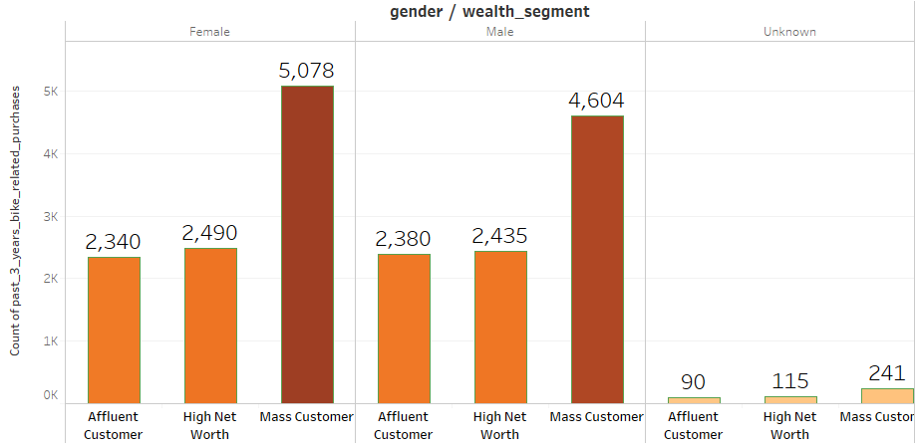
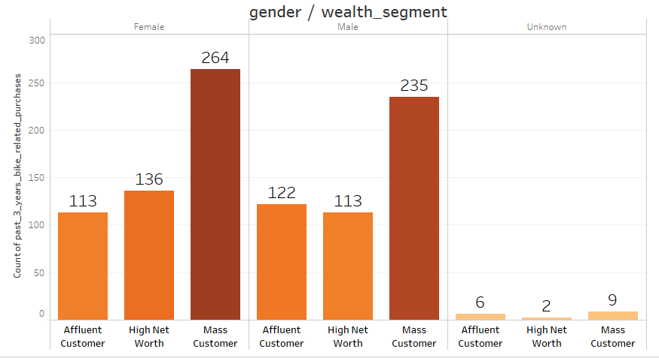
Note: The data and information in this document is reflective of a hypothetical situation and client. This document is to be used for KPMG Virtual Internship purposes only.
Data Exploration
Analysis based on gender and wealth
segment the customers belong to
The customers who purchased bikes belongs to three different wealth segments- Affluent customers, High net worth, mass customers.
Both old and new customers are highest in count are females from mass segment.
The change seen in new customers is that there is a decrement in high net worth male customers.
The strategy should be to make your customer base as your target customers.
OLD
NEW

Slide 6
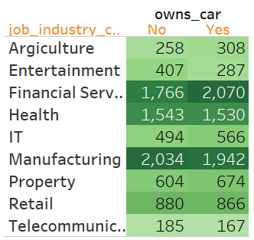
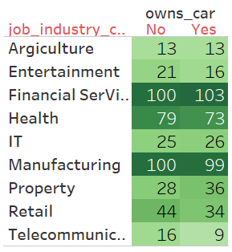
Note: The data and information in this document is reflective of a hypothetical situation and client. This document is to be used for KPMG Virtual Internship purposes only.
Data Exploration
Analysis on the basis of the job industry
category and owner of cars
Given are the highlight tables
where we see among old customers,
The highest belong to financial
service sector who owns cars i.e.
2070. The same pattern is seen in new customers too where highest are 103.
Among new customers, agriculture
domain shows a decrement.
Owning a car or not is not affecting
the purchasing behaviour.
Job category is affecting the number
of purchases.
Target customers can be from financial
Service sector, Health, manufacturing,
Retail etc.
OLD
NEW

Slide 7
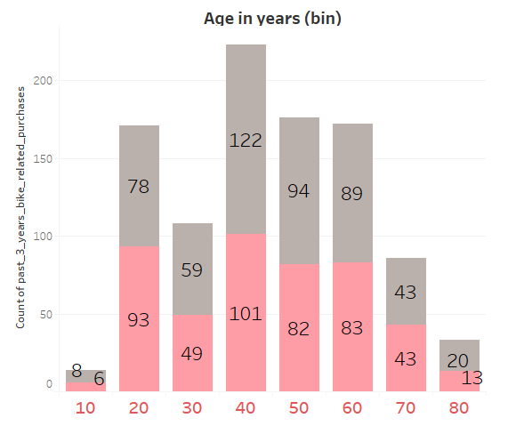
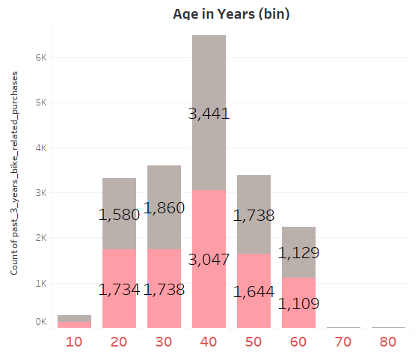
Note: The data and information in this document is reflective of a hypothetical situation and client. This document is to be used for KPMG Virtual Internship purposes only.
Data Exploration
Analysis based on the age of customers
The grey colour denotes females whereas pink denotes males.
The customers who are in their 40s are more interested in the purchase of bikes while the teens and aged show less number of purchases in the old dataset.
Our target customers are thus females in 20s, 40s, 50s.
The next focus should to explore the change in buying behaviours of customers who 70-89 yrs old. There is a decline seen in the new customer.
OLD
NEW

Slide 8
Note: The data and information in this document is reflective of a hypothetical situation and client. This document is to be used for KPMG Virtual Internship purposes only.
Model Development
“If you try to sell to everyone, then you’ll end up selling to no one”
Firstly, we need to know your target customers who will respond positively to the promotions, products and services of your company.
On the basis of demographic, geographic, psychographic and behavioural segmentation, we have understood your customer base which will be your target market.
Target Market on the basis of different factors is given below-
State- New South Wales
Gender- Females
Wealth segment- Mass segment
Age- Mid aged people
Job Industry category- Financial Service sector, Retail, Manufacturing, Health etc.

Slide 9
Note: The data and information in this document is reflective of a hypothetical situation and client. This document is to be used for KPMG Virtual Internship purposes only.
Interpretation
Market Strategies based on the interpretation
Social media strategy should be given emphasis to engage your customers with campaigns, advertisments, products details, promotions, discounts, offers on platforms like Linkedin, Facebook, Instagram etc.
These platforms can be used to address the pain points of customers and get honest reviews from them for improvisations.
This will help to retain the customers and expand the businesse efficiently.

Slide 10
Note: The data and information in this document is reflective of a hypothetical situation and client. This document is to be used for KPMG Virtual Internship purposes only.
Appendix

